Slide 1

Customer Churn Prediction
K.Karthikeya
Innomatics Research Labs

Slide 2
Problem Statement:
Build a predictive model to estimate the likelihood of customer churn for a telecommunication company.
Objectives:
Data Collection
Preprocessing
Exploratory Data Analysis
Feature Extraction
Model Selection
Training and testing
User input prediction

Slide 3
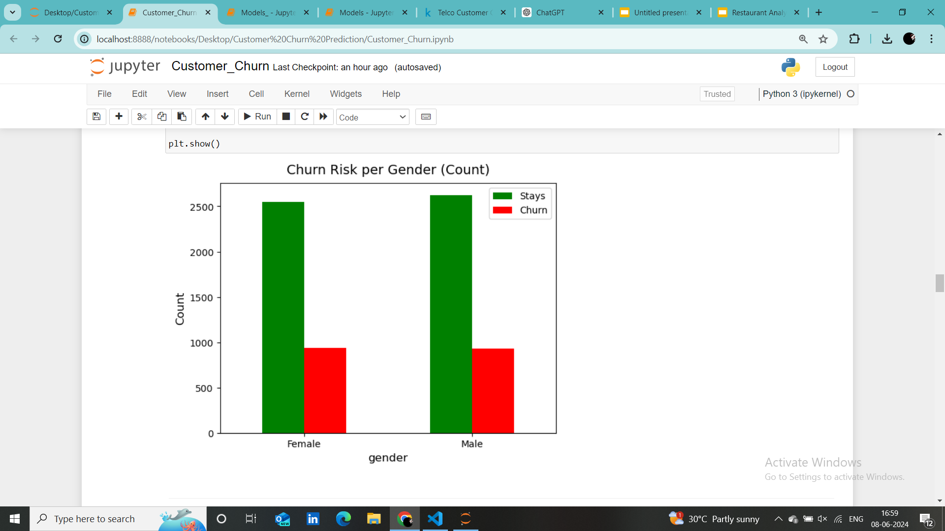
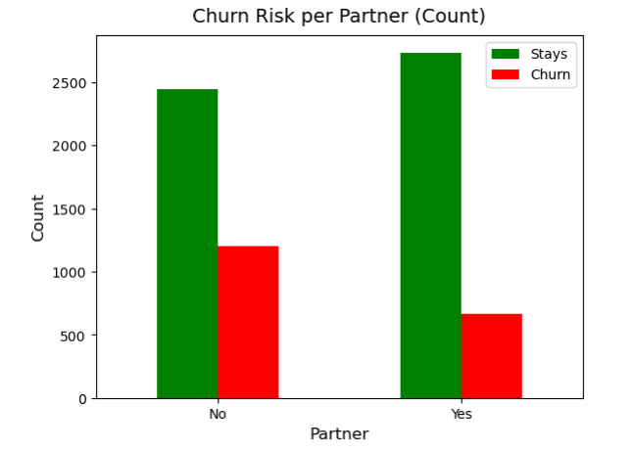
From the graph(1) both male and female are approximately equal likely to churn.
From the graph(2) who are the partner are less likely to churn.

Slide 4
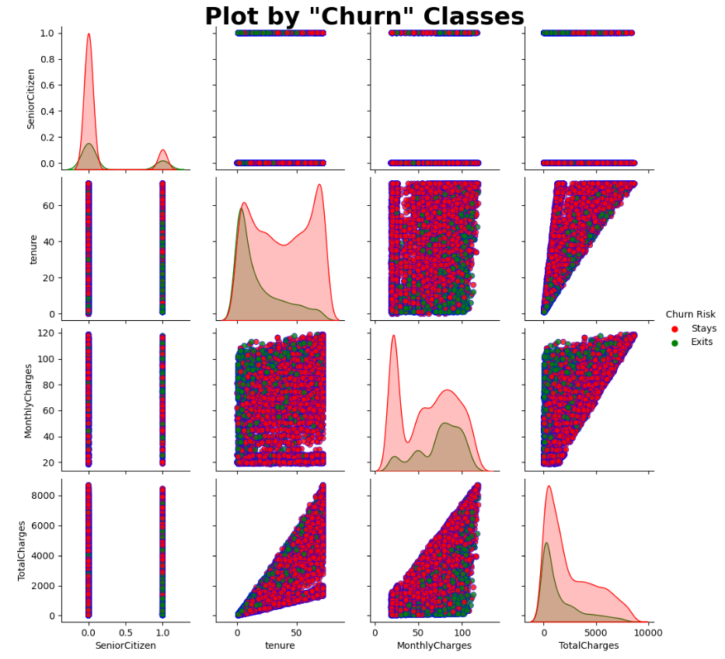
The pairplot shows us the scatterplot between the numerical columns.
As the tenure increases the Totalcharges increases
The relation between Monthlycharges, TotalCharges and Tensure are widely spread across

Slide 5
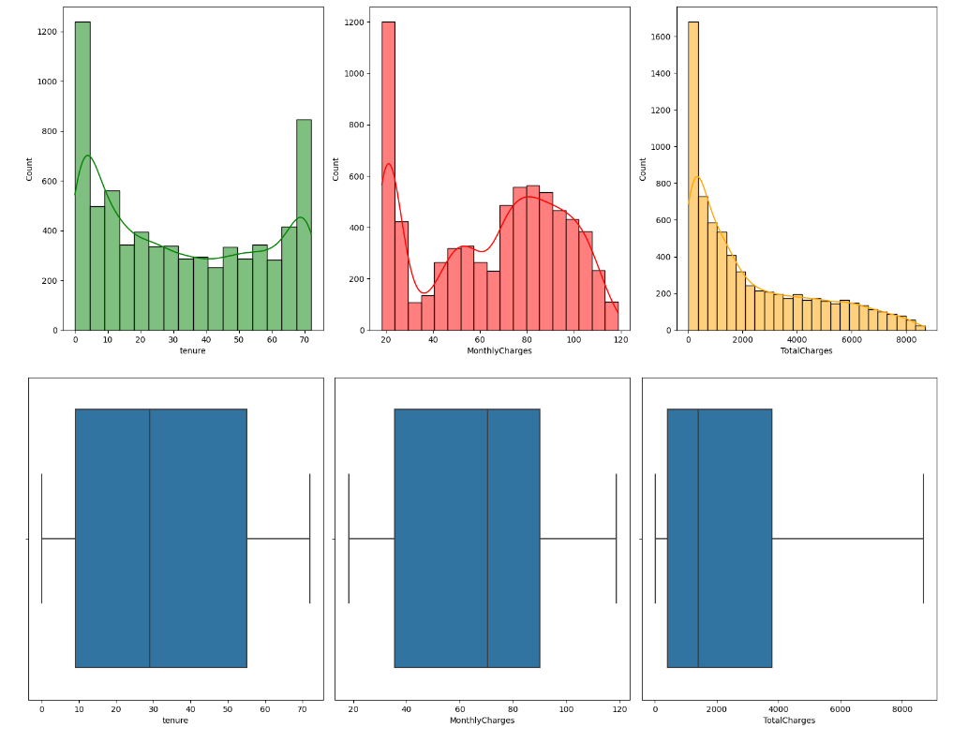
The tenure hist plot tells their are many new joins to the company correspondingly 70 years tenure is 2nd highest
No outliers in the columns, but it is skewed to left side

Slide 6
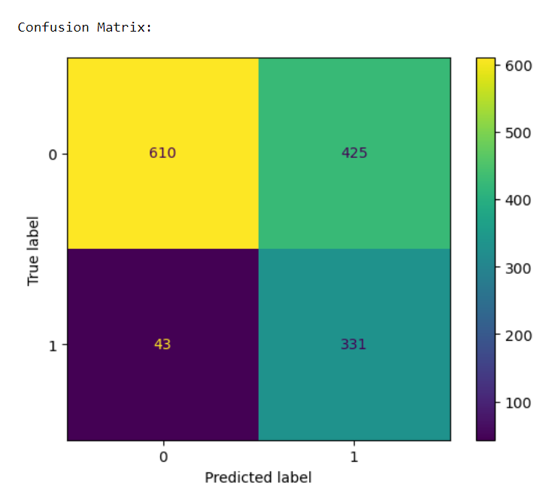
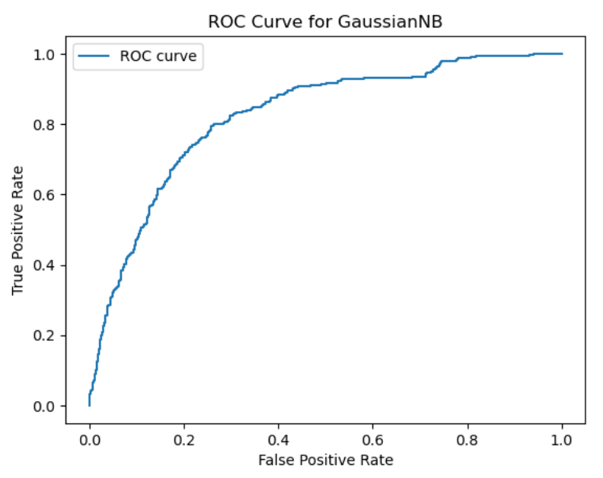
For Prediction : GaussianNB
Because of its good training and testing test rather than others.
It is very fast for predicting binary Classification models in hypertuning process

Slide 7
Conclusion:
Model Insights:
The high ROC-AUC scores indicate that the models have good discrimination ability between churn and non-churn customers.
Precision and recall metrics vary, highlighting different trade-offs between models. For example, RandomForestClassifier shows a higher balance between precision and recall compared to other models.
Feature Importance:
Features such as tenure, MonthlyCharges, TotalCharges, and Contract type (e.g., month-to-month, one year, two year) were significant in predicting churn.
Services like InternetService, OnlineSecurity, and TechSupport also played critical roles in determining customer churn.

